Slide 1
YouTube and WordPress
Mary White
mwhite32@jccc.edu
MaryW@MWforDesigns.com

Slide 2
The Bumper
Notes:
Well like most people with Cars accidents happen. My son’s Honda Accord had the bumper hang off. We got an estimate and it was over 4k for him to replace it. Being a Poor college student and always on the internet he and my husband found a YouTube video that showed step by Step how to replace the bumper on his car. Wow that did not look to hard. They follow the link on the YouTube video ordered the Bumper for ~400.00. Then my Son was able to replace the bumper with an iPad to watch the steps.

Slide 3
YouTube & WordPress
Why should you use YouTube?
Add Video to WordPress Pages & Post
Creating your YouTube Channel
Creating your Video(s)
The Power of WordPress and YouTube

Slide 4
YouTube & WordPress
YouTube 2nd Largest Search Engine and it is owned by the First largest Search Engine Google
Combine that power to get your audience to your brand/content/or Products
WordPress has 30% of All websites loaded on the internet
Can you see how these two things might work perfect together
Drive you customers/ clients to your Website with Videos or to your Videos from your website

Slide 5
Why?
Free to make
Free to host
Free to watch
Images, Audio, and Videos enhance your message

Slide 6
Free to make
What Information can you give people that will help your Brand
Quick Instruction?
Funny Story
Notes:
We all have a phone or know someone that does and the webcams and Video Camera are in a large number of homes already.

Slide 7
Free to Host
free video uploads
YouTube servers
Notes:
This number is growing exponentially 2020 predictions around 3-5 billion

Slide 8
Free to watch
Unlike Netflix you don’t have to pay to watch the content on YouTube
1.5 billion active subscriber

Slide 9
enhance your message
Images, Audio, and Videos enhance your message
Videos enhance like no other media
Story Telling
Immediate information
Replay for understanding
YouTube also has the Social
Sharing
Commenting
Subscribing

Slide 10
Adding Video to WordPress
Four Steps to add a Video to your
Page or Post

Slide 11
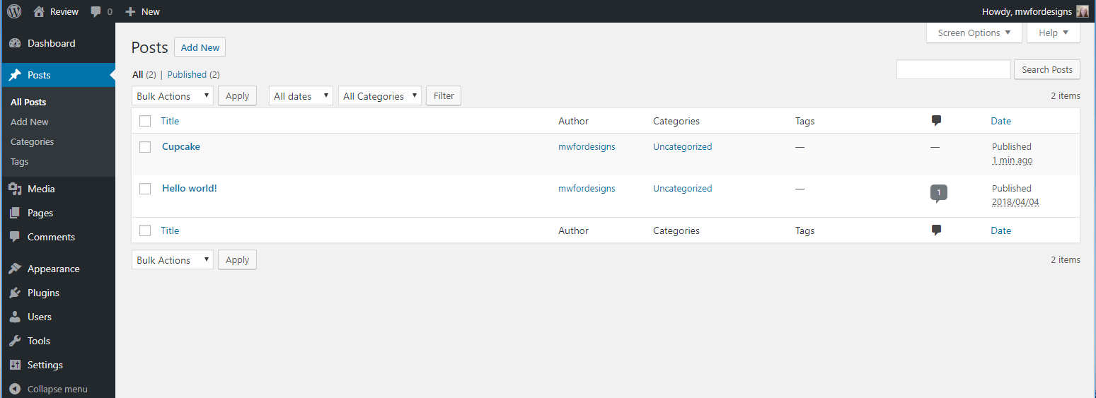
Adding Video to WordPress
Dashboard

Slide 12
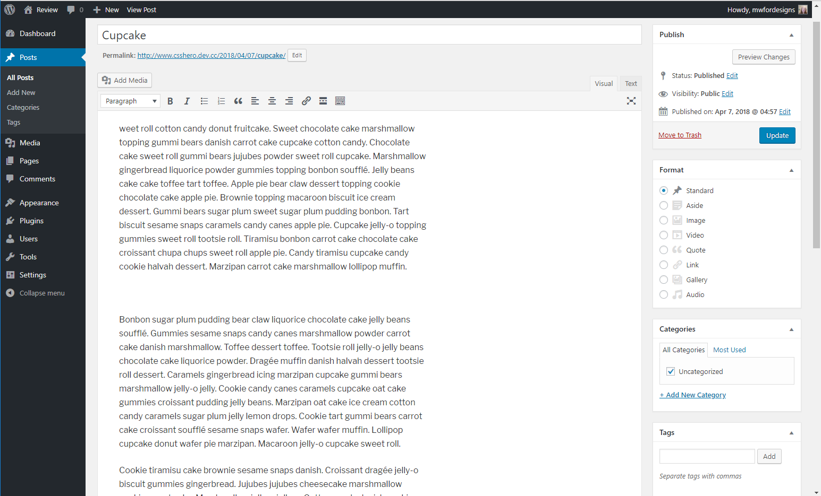
Adding Video to WordPress
Page or Post edit

Slide 13
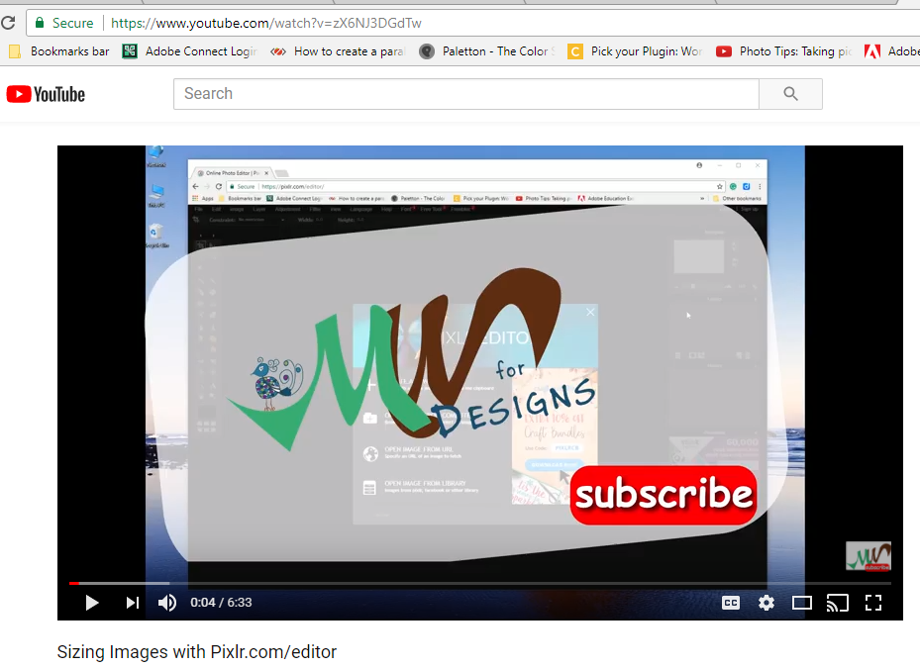
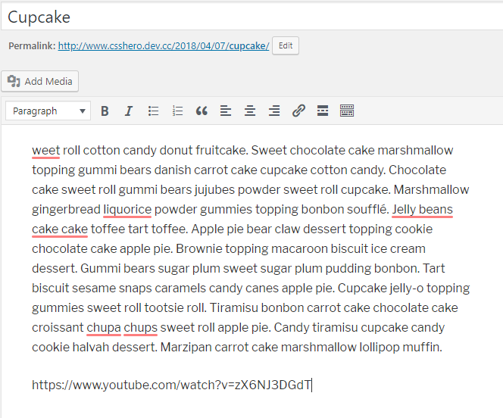
Adding Video to WordPress
Copy URL from YouTube and
Paste Video URL into your post

Slide 14
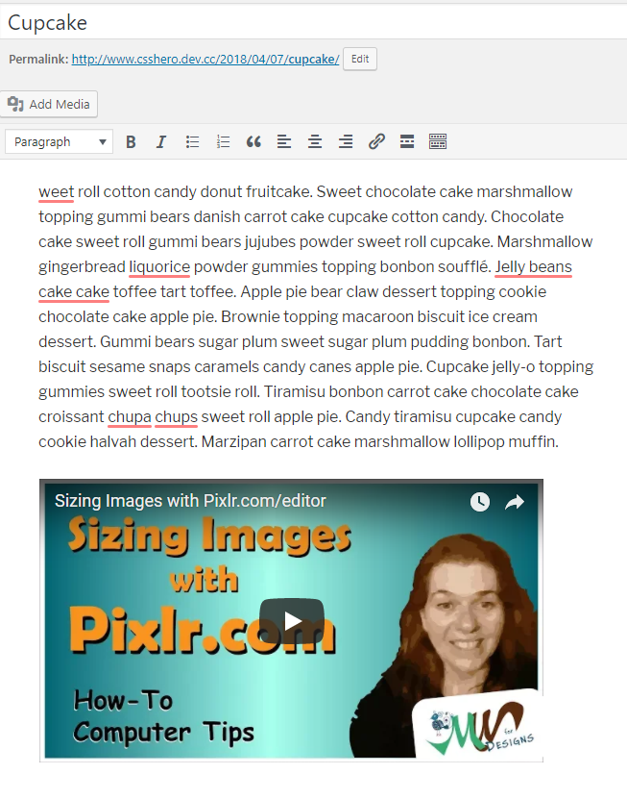
Adding Video to WordPress
Video will display in your post or page now.

Slide 15
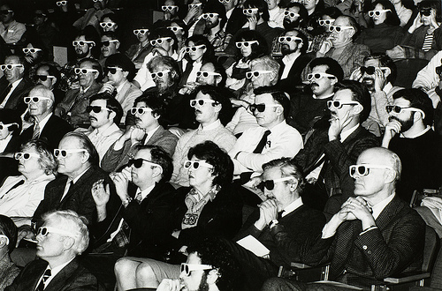
A WordPress Website is for…
YouTube videos can expand your audience

Slide 16
Creating a YouTube Channel
You need a g-mail account
Describe the Goal of the Channel
Write a hook description that will let people know what your channel is about
Create a Short video Trailer to reinforce your description

Slide 17
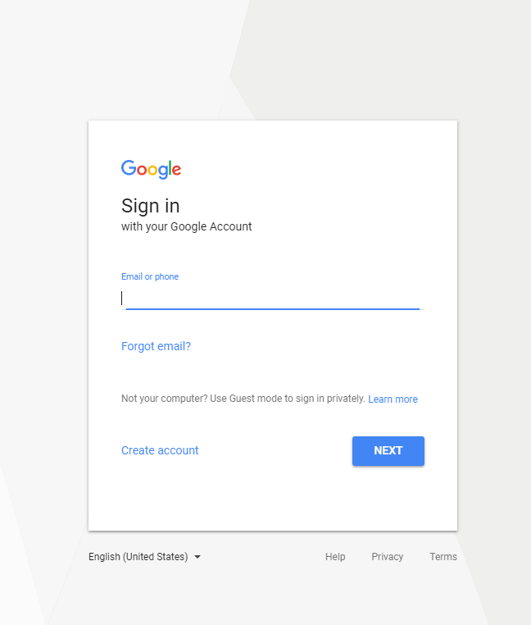
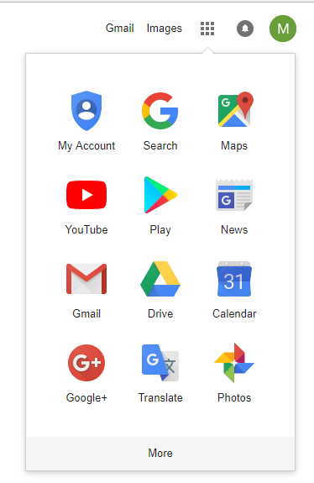
Creating a YouTube Channel
1st you need a gmail account

Slide 18
Branding your YouTube Channel
Describe the Goal of the Channel
Write a hook description that will let people know what your channel is about
Create a Short video Trailer to reinforce your description

Slide 19
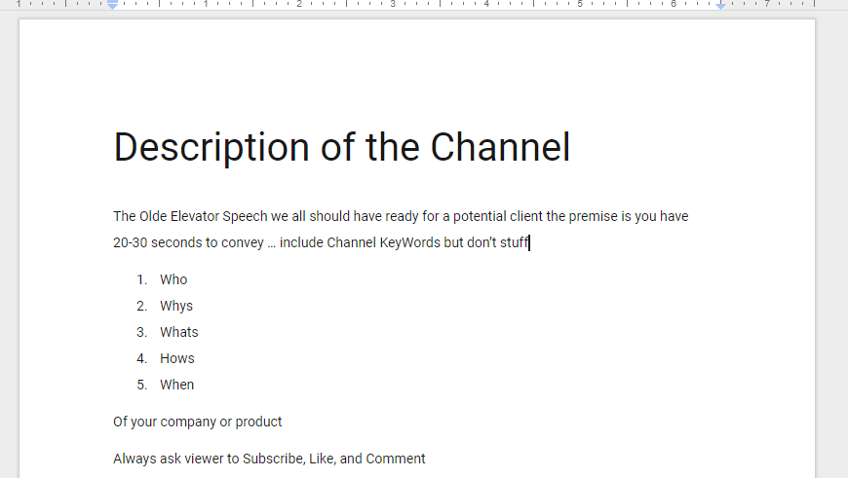
Creating a YouTube Channel
Describe the Goal of the Channel
Write a hook description that will let people know what your channel is about

Slide 20
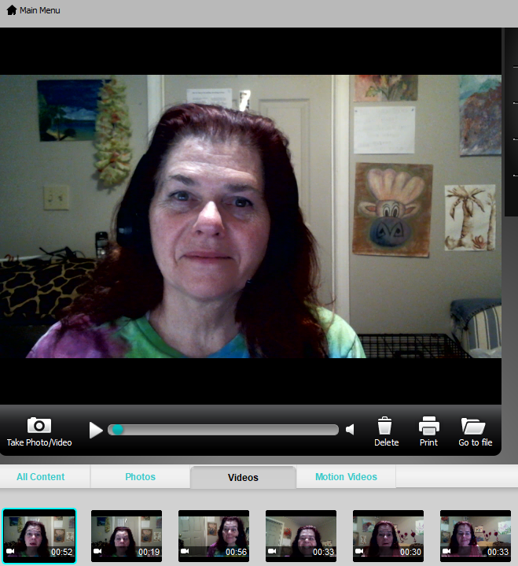
Trailer Video YouTube Channel
Create a Short video Trailer to reinforce your description

Slide 21
How to Add to your YouTube Channel
Add this description
Add Video Trailer to your YouTube Channel
Your YouTube>Channel_Icon>CreatorStudio
View Channel>Customize Channel>About … place your written description here
View Channel>Customize Channel>For new Visitors … place your trailer video here

Slide 22
How to Add to your YouTube Channel
Add this description
Add Video Trailer to your YouTube Channel

Slide 23
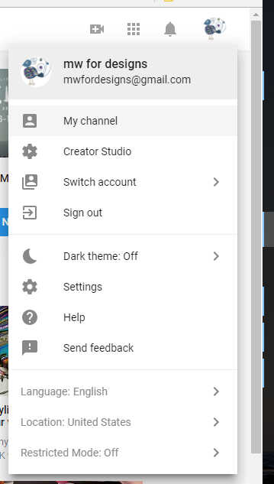
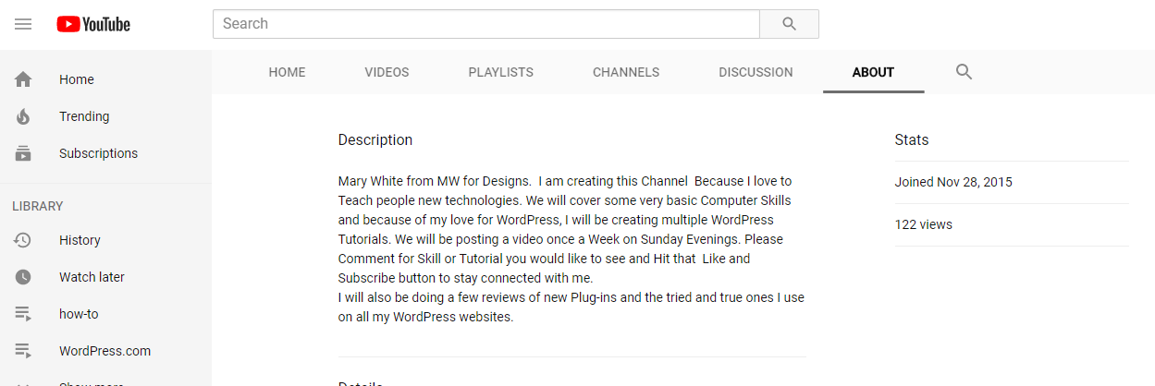
Add your Description
Your YouTube>Channel_Icon>CreatorStudio
View Channel>Customize Channel>About … place your written description here

Slide 24
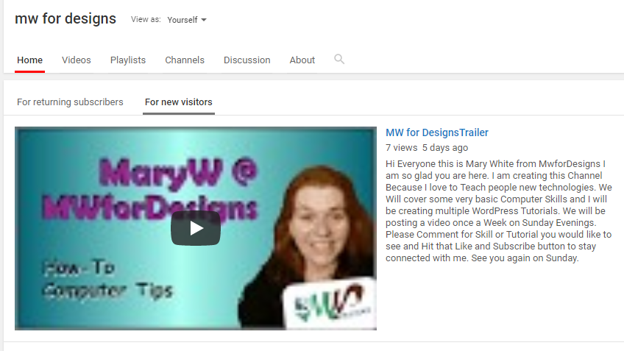
Add Your Video Trailer
View Channel>Customize Channel>For new Visitors … place your trailer video here

Slide 25
Before Creating your YouTube Channel
Attract an Audience
Friends
Family
Social media
Email list
Facebook follower
LinkedIn
Twitter
Subscriber/Followers

Slide 26
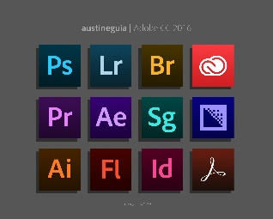
Brand your YouTube Channel
Design…
Adobe products
Free Online Tool Pixlr.com
Create the Follow
Logo
Background
Creative Thumbnails

Slide 27
Design Specifications…
Logo
Profile Photo: 1000 x 1000 pixels - The profile photo is displayed as 250 x 250 pixels,
Background
Channel Art: 2560 x 1440 pixels
Creative Thumbnails
1920×1080 pixels

Slide 28
Logo
Design…
Logo
Profile Photo: 1000 x 1000 pixels - The profile photo is displayed as 250 x 250 pixels

Slide 29
Background
Design…
Background
Channel Art: 2560 x 1440 pixels

Slide 30
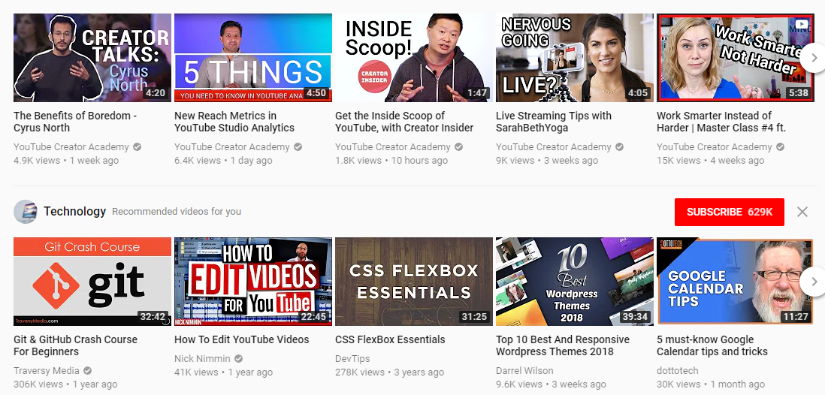
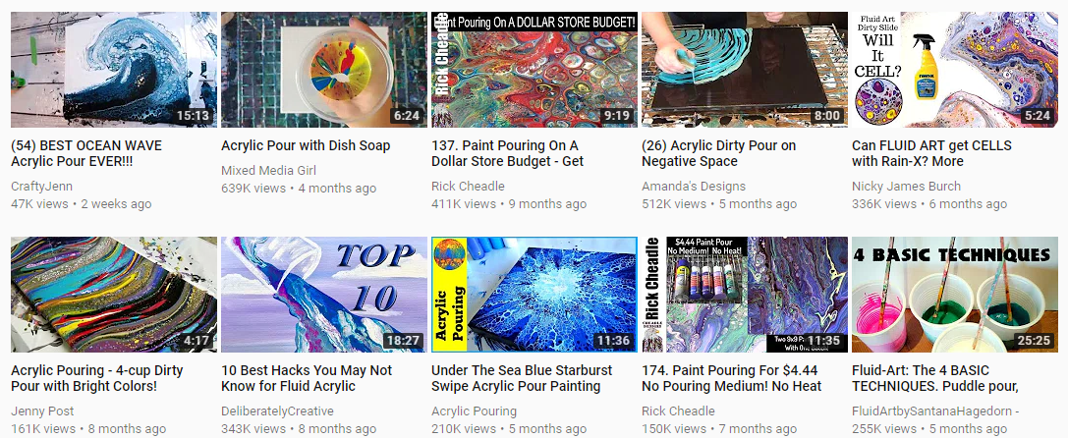
Creative Thumbnails
Design…
Creative Thumbnails
1920×1080 pixels
Notes:
Add Catch Title to the Thumbnail, in your video file name, in the description of the video, and add a great description with links and other information talked about in the video.

Slide 31
Modifying your YouTube Channel
Brand the channel
Add Logo
Creator studio>Channel> Advanced

Slide 32
Modifying your YouTube Channel
Brand the channel
Add Background
Channel icon> mychannel

Slide 33
Modifying your YouTube Channel
Brand the channel
Add at upload time select Thumbnails

Slide 34
Creating Video
Free to host on the Second Largest Search Engine
Free to Create
Free to Promote
The Cost is your
Creativity
Time
Effort

Slide 35
Creating a YouTube Video
Research your Topic
Research the Competition

Slide 36
Creating a YouTube Video
Develop your idea
Create a compelling Story

Slide 37
Creating a YouTube Video
Storyboard your Shots
SEQUENCE the shots with your story

Slide 38
You have HD video recording tool in your pocket and with all your mobile devices.

Slide 39
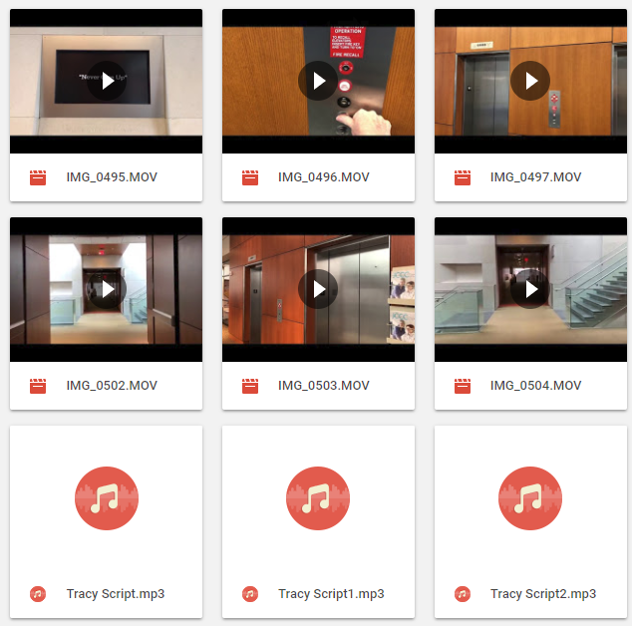
Creating a YouTube Video
Record your Audio
Film your Shots
Or do both together

Slide 40
Creating a YouTube Video
Edit your scenes together
Moviemaker for PC
Imovie for macs
Optimizes them
Remove lags or pauses
Remove yummmmm andddds
Have filler shots to transitions between scenes

Slide 41
The Power of YouTube & WordPress
Both Platforms are Social
Comments
Liking
Sharing on other Social outlets
Both Drive Clients / Customers / Donors to your Brand

Slide 43
Google and YouTube
1.5 billion active users in a month
All you need is an idea and g-mail account
Number of active subscribers by 2020 between 3-5 billion

Slide 44
The Power of YouTube
YouTube Usage Statistics
YouTube User Statistics

Slide 45
YouTube Usage Statistics
YouTube is the world’s second largest search engine and third most visited site after Google and Facebook
300 hours of video are uploaded to YouTube every minute
We watch over 1 billion hours of YouTube videos a day
More than half of YouTube views come from mobile devices
The average mobile viewing session lasts more than 40 minutes
The first video to hit one million views was a Nike advert featuring Ronaldinho
The video with the highest number of views is currently the music video for ‘Despacito’ by Luis Fonsi and Daddy Yankee. It has over 4.7bn views
It took Gangnam Style, a previous most watched video, five months to hit 1 billion views. In comparison, Despacito took just 97 days
The video with the most views that isn’t a music video is ‘Huge Eggs Surprise Toys Challenge’ by Ryan ToysReview. It currently has over 1bn views
On average, there are 1,000,000,000 mobile video views per day
In 2014, the most searched term was music. The second was Minecraft
The time people spend watching YouTube on their TV has more than doubled in the last year

Slide 46
YouTube User Statistics
6 out of 10 people prefer online video platforms to live TV
By 2025, half of viewers under 32 will not subscribe to a pay-TV service
In an average month, 8 out of 10 18-49 year-olds watch YouTube
In 2015, 18-49 year-olds spent 4% less time watching TV while time on YouTube went up 74%
On mobile alone, YouTube reaches more 18-49 year-olds than any broadcast or CABLE TV network
You can navigate YouTube in a total of 76 different languages (covering 95% of the Internet population)
The platform has also launched in over 88 countries
Daniel Middleton, better known as DanTDM, is the highest earning YouTuber, bringing in $16.5m in 2017

Slide 47
Making Money
YouTube will pay you if you have 4000 hours and 1000 subscriber in 2018
Run Contest with Gleam.io
You can move people to your Brand service / Product you are selling
You can have affiliation with Products and Promote them to make money
I am an affiliate with Desktop Server by ServerPress
You can team up with people in tangent niches
(I am reviewing a Plug-in for CSSHero)

Slide 48
Conclusion
Why Should you use YouTube?
Video on WP are easily added
Brand your Channel for YouTube
Video Production can be Easy(have a Plan)
Harness the Power of YouTube being a Search Engine and WordPress being a major Website development platform
Making Money

Slide 49
Questions?
Slide Share
https://www.slideshare.net/mwfordesigns/you-tubeampwp/mwfordesigns/you-tubeampwp
Or TinyURL
https://tinyurl.com/ybowqxpd

Slide 50
Contact Me
Mary White
mwhite32@jccc.edu
MaryW@MWforDesigns.com

Slide 51
Follow Mary White
MWforDesigns
MWforDesigns.com
@MW4Designs
mwhite32@jccc.edu
maryw@mwfordesigns.com

