Slide 1
DELIGHT WITH UX DESIGN RACHEL KORPELLA

Slide 2
UX DESIGN:
making a website easy and pleasant for the audience to use
Notes:
What is UX design?
User experience - making a website easy and pleasant for the audience to use
Similar to kitchen design, or closet design, it is simply an organization of tools to make your goals attainable

Slide 3
WHY UX DESIGN? You want the user to…
CONTINUE
CONVERT
COME BACK
Notes:
CONTINUE - People want to move quickly through a website - if it doesn’t get to the point or give them the answers they need, they will move on. You have 8 seconds to keep attention
What is this? (Usefulness)
How do I use it? (Usability)
Why should I care? (Desirability)
CONVERT - You want to give your visitors clear directions, so they convert - that is, do what you want them to do.
A completed purchase
A submitted form
A button or link click
Reaching a particular page
COME BACK - You want your visitors to enjoy using your website, so that they will come back.
Don’t make people have to think too hard
Don’t strain the eyes

Slide 4
HOW TO ACHIEVE UX DESIGN
Keep it SIMPLE
Use CONVENTIONS
Give LOCATION clues
Design for MOBILE
Use a HIERARCHY
Increase your SPEED
Optimize your PHOTOS

Slide 5
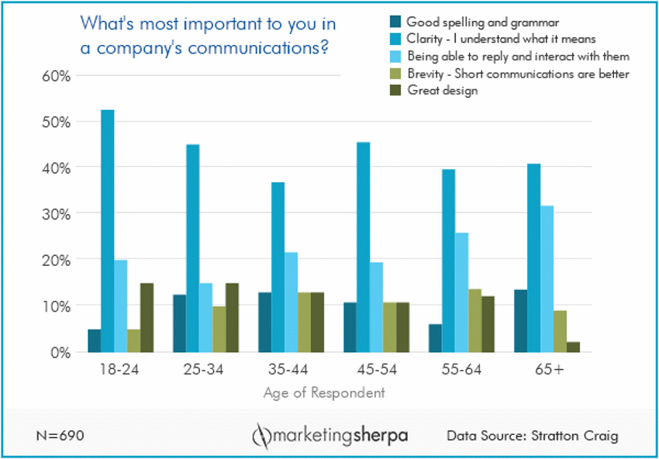
Notes:
CLARITY over design

Slide 6
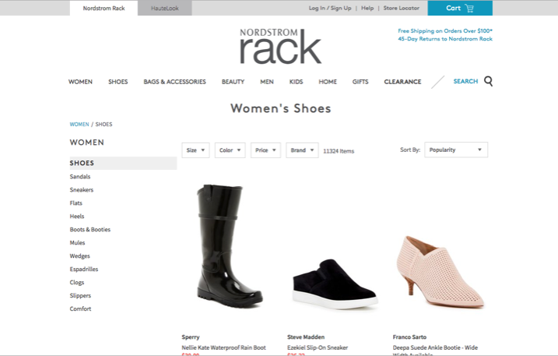
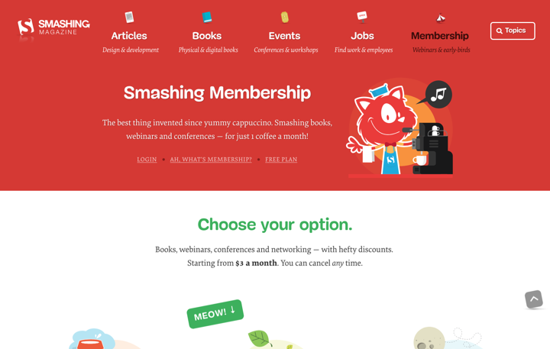
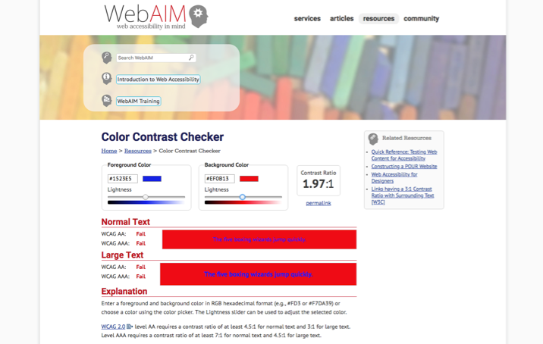
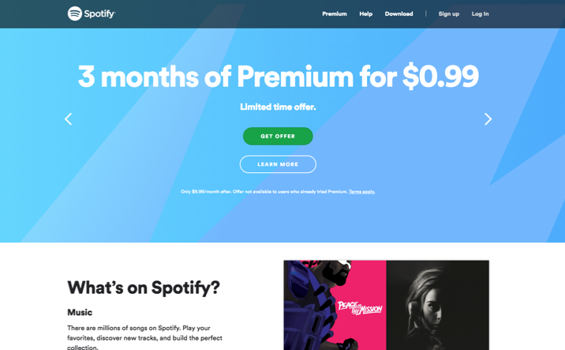
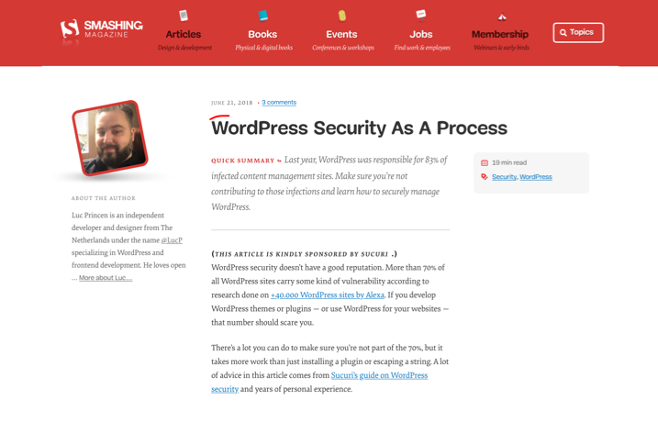
SIMPLE
CLEAN
CONTRAST
LINKS
TEXT
CONSISTENCY
Notes:
SIMPLE
-CLEAN design, not a lot of competition for attention
-CONTRAST to make it easy on the eyes
-Make LINKS/buttons obvious
hover/rollover/click effects
Clear CTA
-Reduce excess TEXT
Short sentences
Use lists where applicable
Descriptive links within text, not “click here”
CONSISTENCY within website
Backgrounds, colors, fonts
Same layouts for similar pages

Slide 7
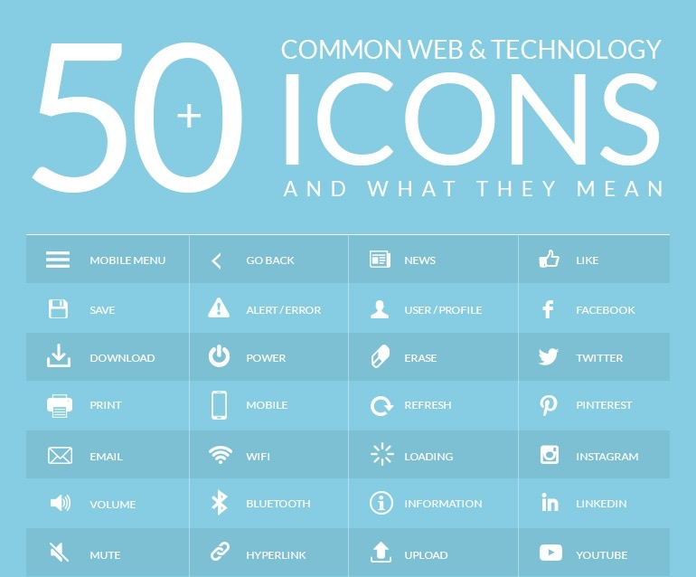
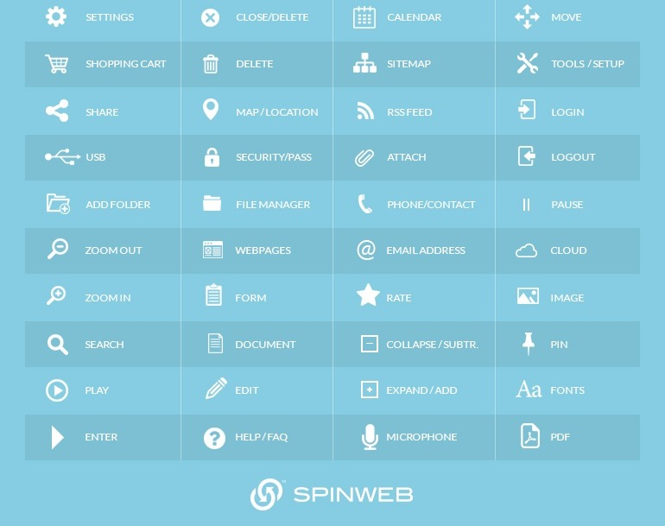
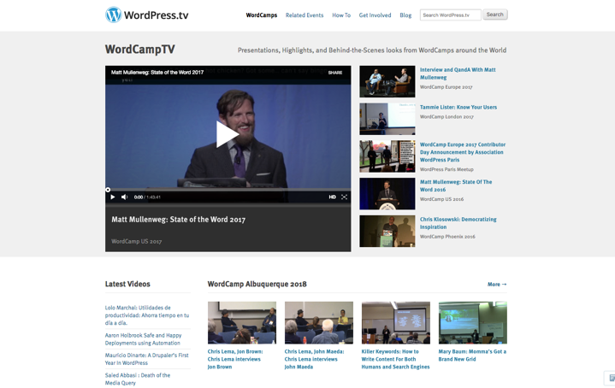
CONVENTIONS
HOME
SEARCH
NAVIGATION
ICONS
Place your screenshot here
Notes:
CONVENTIONS - Place functions where people expect them to be - (like vehicle controls)
-HOME button - clickable logo - top left or centered
On every page so users can always start over
-SEARCH bar - top right
-NAVIGATION bar - Clear - Simple - across top or stacked at left
Ideally no more than 3 levels deep
Provide alternate nav options (shortcuts)
Use hover effects
-Use common ICONS

Slide 8
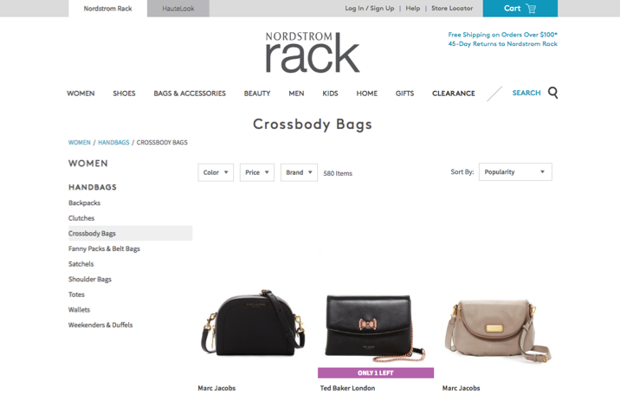
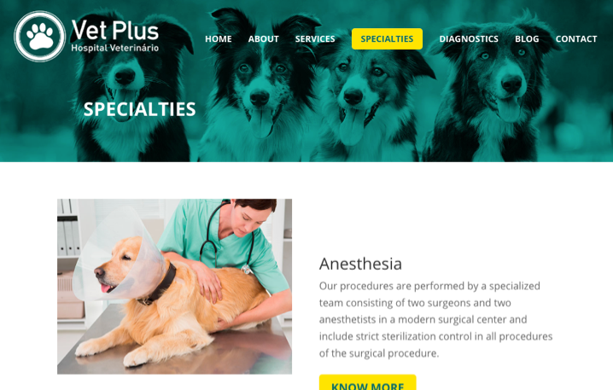
LOCATION
USER CONTROL
PAGE INDICATORS
HEADER IMAGES
BREADCRUMBS
Place your screenshot here
Notes:
LOCATION - Help users be confident of where they are
Put the USER in CONTROL
Reduce dependency of back button
PAGE INDICATORS - nav bar
Use of HEADER PICTURES
-BREADCRUMB trail optional
Secondary Nav - does not take place of Nav bar
Only use with many layers of info or products

Slide 9
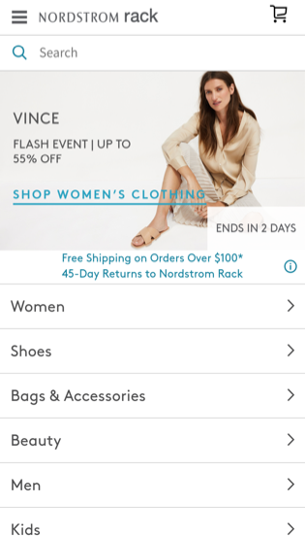
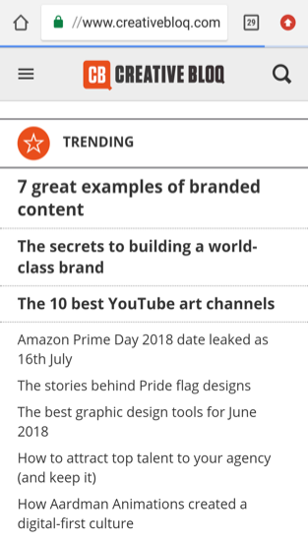
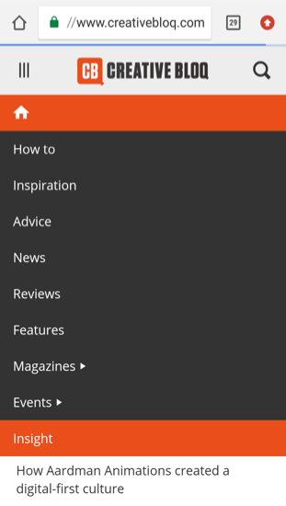
MOBILE
RESPONSIVE
CONSISTENT
REDUCE IMAGES
HAMBURGER MENU
Place your screenshot here
Notes:
Design for MOBILE first, then web
RESPONSIVE design is the standard now
Design for CONSISTENT experience across all devices
REDUCE IMAGES if necessary so info stands out more
HAMBURGER menu - top right - mobile only

Slide 10
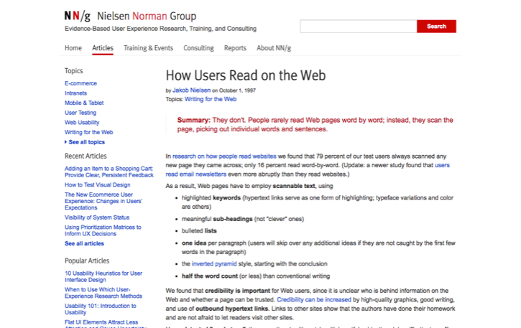
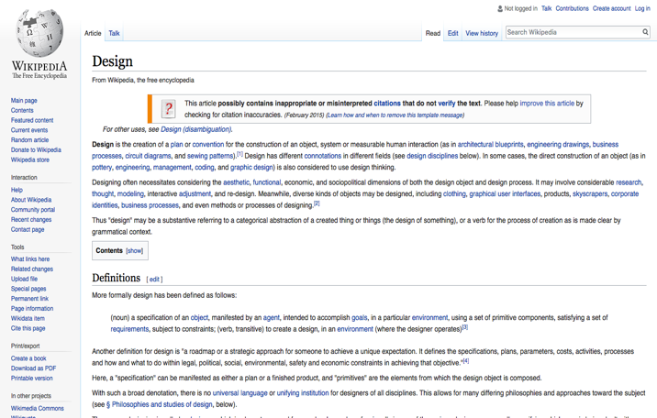
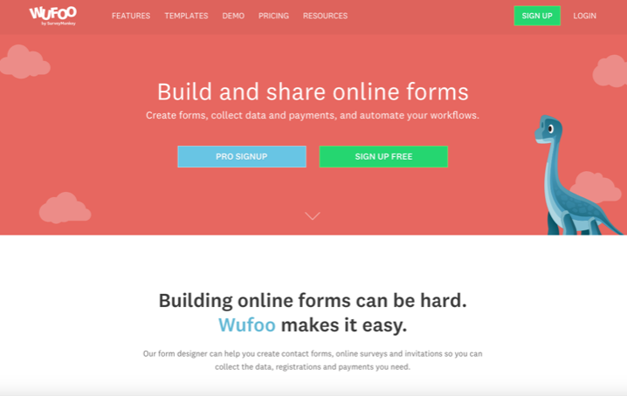
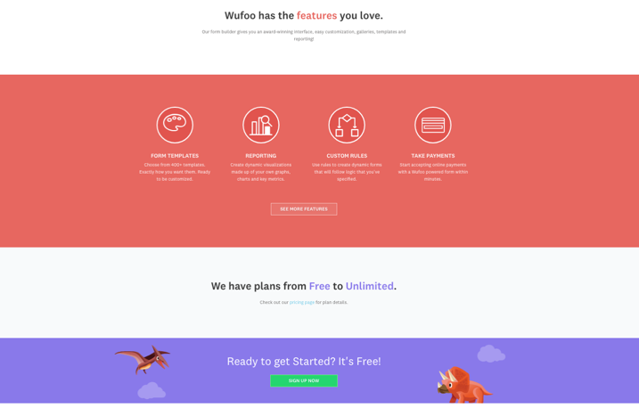
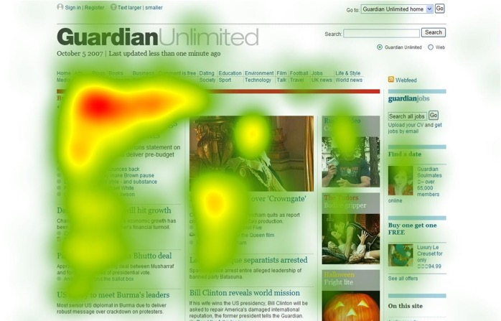
HIERARCHY
SCANNABLE
GUIDE THE EYES
PRIORITIZE
DEFINED SECTIONS
Place your screenshot here
Notes:
Visual HIERARCHY - The arrangement and presentation of elements in order of importance
SCANNABLE People are going to scan your text whether you like it or not. Help them!
Break up text with Subheads
Keyword links
Avoid small type
Lists or images prefered over paragraphs
GUIDE THE EYES with text and photos
F Pattern for text heavy websites
Z Pattern for all other websites
Dominant visual element - weight
Rule of thirds
Position, Emphasis, Movement, Eye Gaze
PRIORITIZE Put the most important information first
Clearly DEFINED SECTIONS
Do not “wikipedia” wall of words

Slide 11
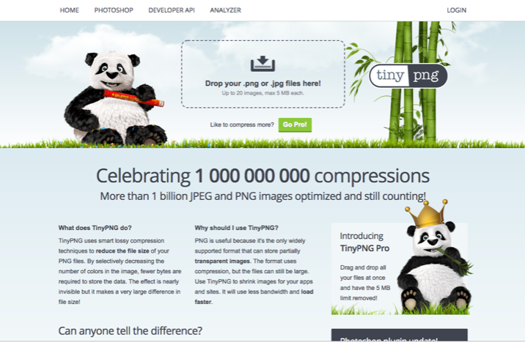
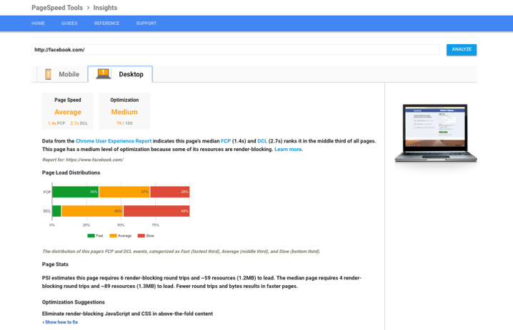
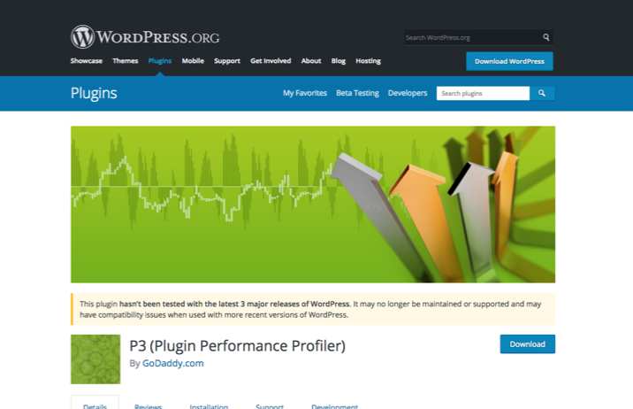
SPEED
HOSTING
PLUGINS
PHOTOS
Place your screenshot here
Notes:
SPEED
HOSTING
Google pagespeed tools
PLUGINS
Not just how many, but how resource heavy
Again, Google page speed tools
PHOTOS
Number of photos
Size of photos

Slide 12
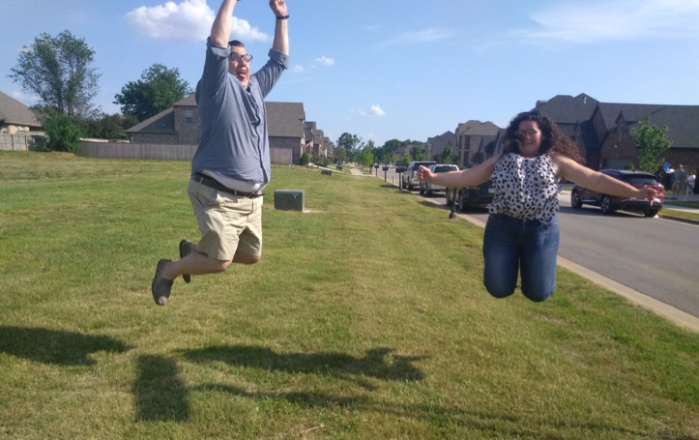
PHOTOS
REAL
STRONG IMAGERY
ACTION
FIT
RELATE
Place your screenshot here
Notes:
PHOTOS
Use real images when possible, (even staged) not stock
Quick online photography lessons for added value
Must look nice
WC 2017 - Strong Imagery
Sets the tone for your brand
Enhances content, not distracting
Conveys emotion
Encourages communication
Action is best
Create Movement
Must fit the space
Heroes must be wide
Must relate to content

Slide 13
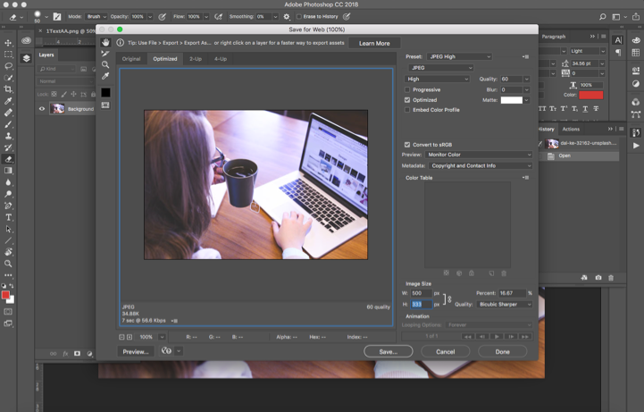
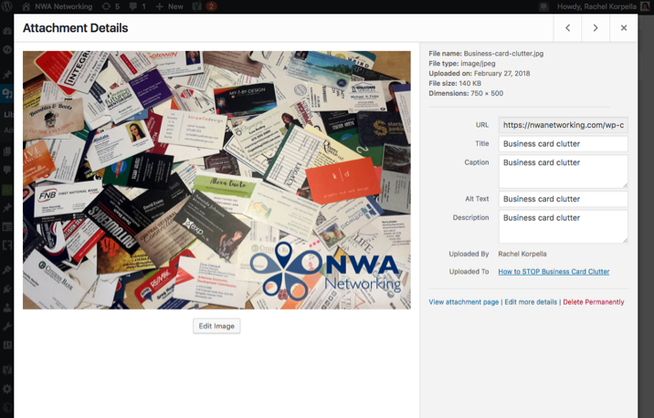
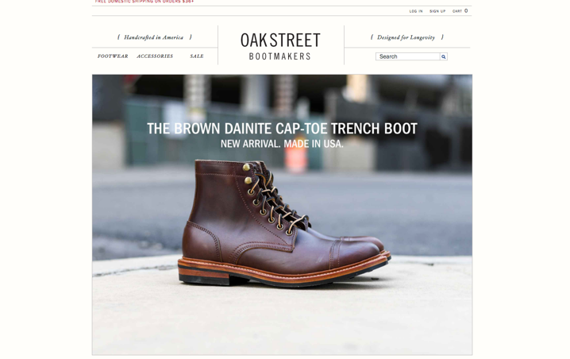
PHOTOS
COMPRESS
ALT + CAPTIONS
FACES
CAROUSEL
Place your screenshot here
Notes:
Must be compressed
Photoshop “save for web”
Use Captions & Alt text
People like to see faces and eyes
White space
Rule of thirds
Do not overuse carusel
Let users have control

Slide 14
FURTHER RESEARCH
DON’T MAKE ME THINK
Steve Krug
SMASHINGMAGAZINE.COM
Search usability
HUBSPOT.COM
Search usability
CREATIVE BLOQ
Search UX
DIGITALSYNOPSIS.COM
Search hierarchy
CREATIVEBLOQ.COM
Search UX
Notes:
Resources
Final Thoughts
Web design is not the place for breaking the mold
Users have a reason for going to your website, and it’s not admiration
There are no hard rules
Do your own testing
The only thing we know about the future of the web is that it will change
Dissatisfaction is the result of unmet expectations

Slide 15
CONNECT WITH RACHEL
rachel@korpelladesign.com
korpelladesign.com
Notes:
Resources
Final Thoughts
Web design is not the place for breaking the mold
Users have a reason for going to your website, and it’s not admiration
There are no hard rules
Do your own testing
The only thing we know about the future of the web is that it will change
Dissatisfaction is the result of unmet expectations

