Slide 1
Wordpresspreneur.

Slide 2
What up!
I’m Dominick Montgomery
I am here because I want to change some things about our industry.
@dominick_tmg

Slide 3
The Problem.
1.
Habitual Freelancing

Slide 4
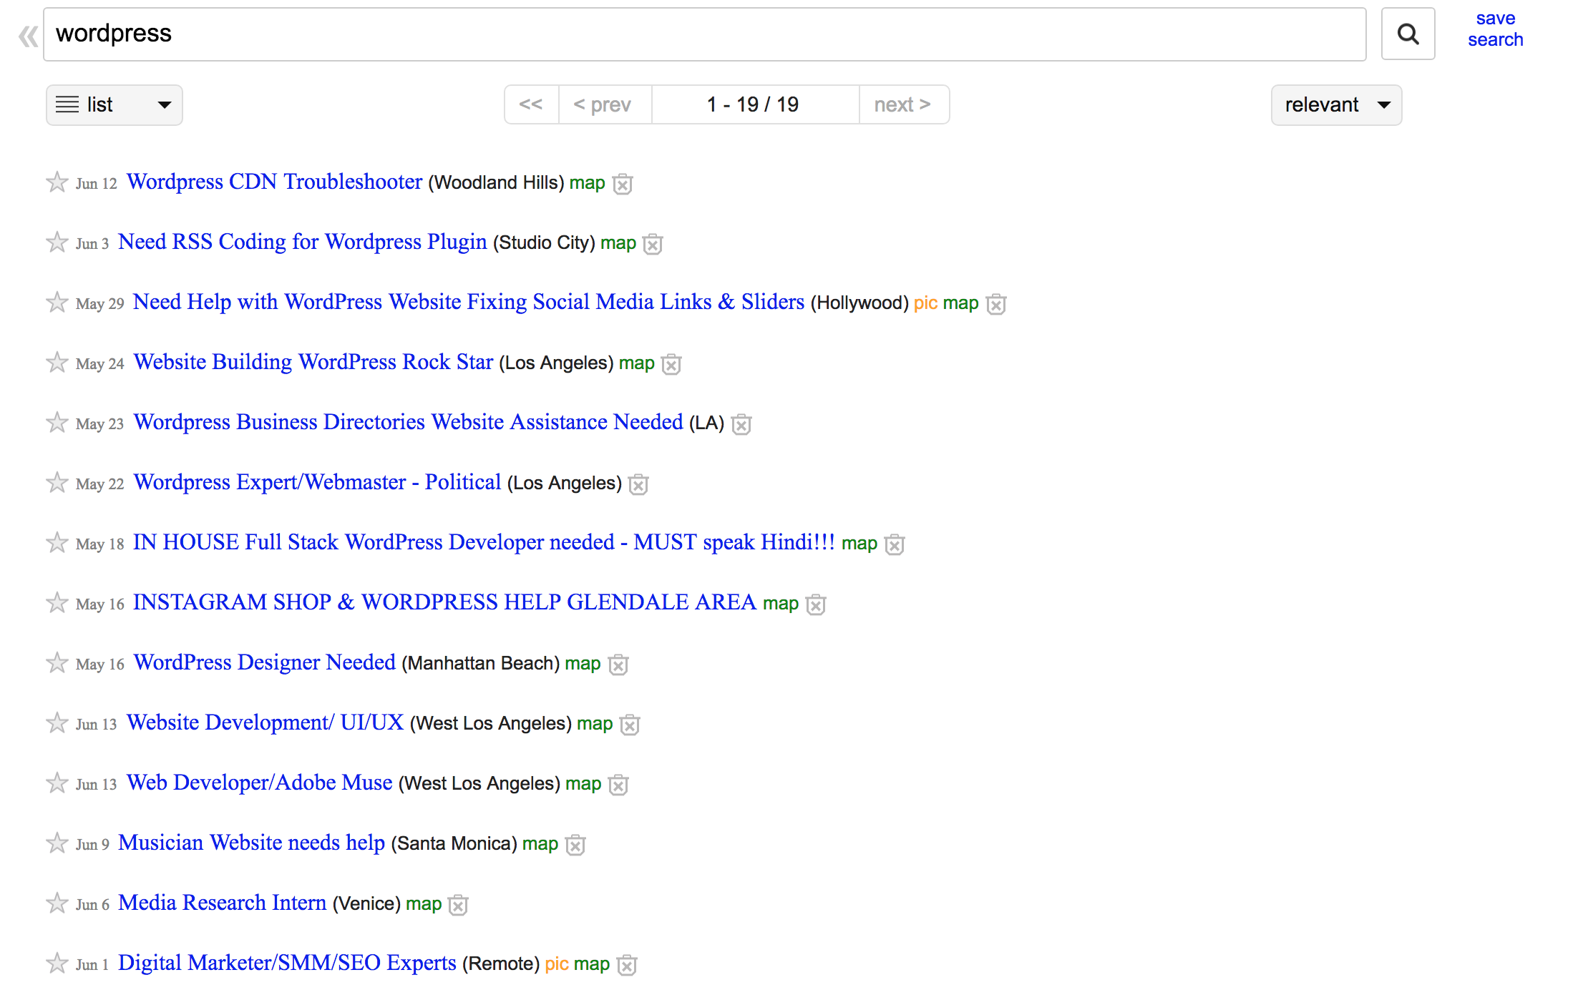
Want big impact?
Use big image.

Slide 5
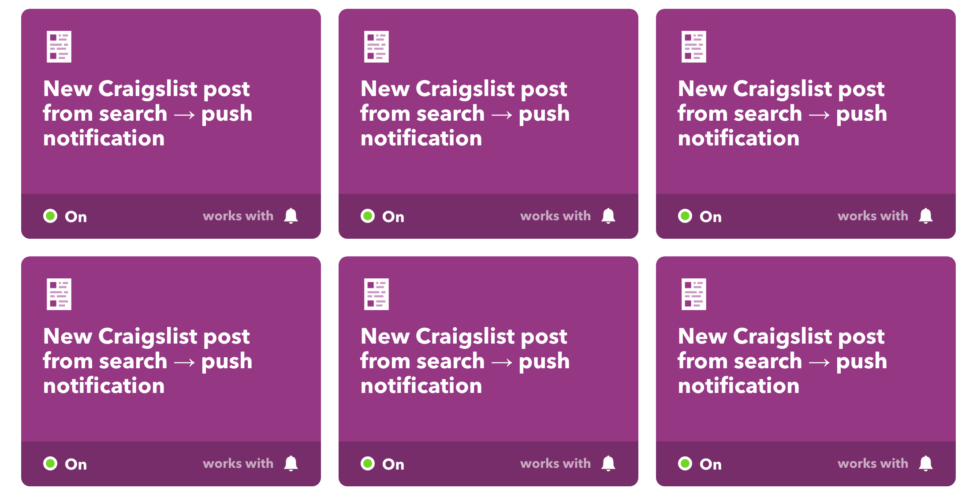
Want big impact?
Use big image.

Slide 6
Want big impact?
Use big image.

Slide 7
What are we doing?

Slide 8
There are only 3 possible outcomes with this strategy IF it works.
You’re underpaid.
You’re overworked.
You’re not valued. Because...Craigslist. (Or Upwork, Fivver, Freelancer, WPCurve)

Slide 9
FREELANCING IS NOT SUSTAINABLE.
At some point you have to insert your worth into your mission.

Slide 10
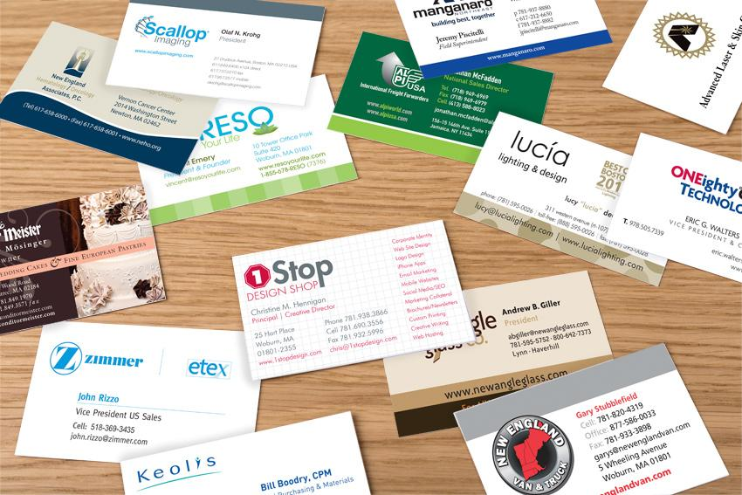
Want big impact?
Use big image.

Slide 11
What are we doing?

Slide 12
We’re getting killed because we’re proud of being called a “Freelancer”.

Slide 13
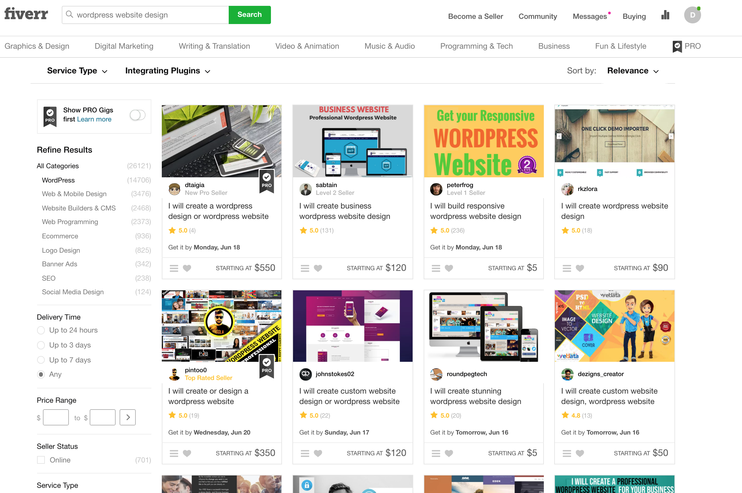
Want big impact?
Use big image.

Slide 14
Want big impact?
Use big image.

Slide 15
We work with all types of industries. We provide custom solutions and next-level strategies for markets far and wide.

Slide 16
Ours.

Slide 17
So how do we define our target market?

Slide 18
Want big impact?
Use big image.

Slide 19
The Process Of Defining Your Niche.
Industry Research
What industries are used to paying premium costs for work we feel is “easy”?

Slide 20
The Process Of Defining Your Niche.
Industry Research
What industries are used to paying premium costs for work we feel is “easy”?
Define a Problem
How can you provide more value than the “competitors” in this space?

Slide 21
The Process Of Defining Your Niche.
Industry Research
What industries are used to paying premium costs for work we feel is “easy”?
Define a Problem
How can you provide more value than the “competitors” in this space?
Attack That Shit
Find a way in. Find an issue with their online efforts and let them know about it.

Slide 22
[Enter]
2.
Michael Gonzalez.

Slide 23
Want big impact?
Use big image.

Slide 24
The Questions You Ask Determine Your Worth.

Slide 25
The Questions You Ask Determine Your Worth.
I Need A New Website.
Sure we can do that. Here’s our process. Here’s our price. Here’s how long it will take. Does that sound good? Great, I’ll send you a proposal!

Slide 26
The Questions You Ask Determine Your Worth.
I Need A New Website.
Sure we can do that. Here’s our process. Here’s our price. Here’s how long it will take. Does that sound good? Great, I’ll send you a proposal!

Slide 27
The Questions You Ask Determine Your Worth.
I Need A New Website.
Sure we can do that. Here’s our process. Here’s our price. Here’s how long it will take. Does that sound good? Great, I’ll send you a proposal!
I Need A New Website.
That’s great that you’re stepping your game up. Can you tell me a little about your practice? Where are you located? Is there tons of competition? Do you want leads or notoriety?

Slide 28
Standard Site Cost: $5,000.

Slide 29
Asking the right questions and establishing a genuine relationship:
$25k + $3500/mo

Slide 30
How do we get more clients like this?
3.

Slide 31
Acquire Leads.
Paid Ads
Rankings
Cold Outreach
Word of Mouth

Slide 32
We have to become more than developers & designers.

Slide 33
Want big impact?
Use big image.
SALES?

Slide 34
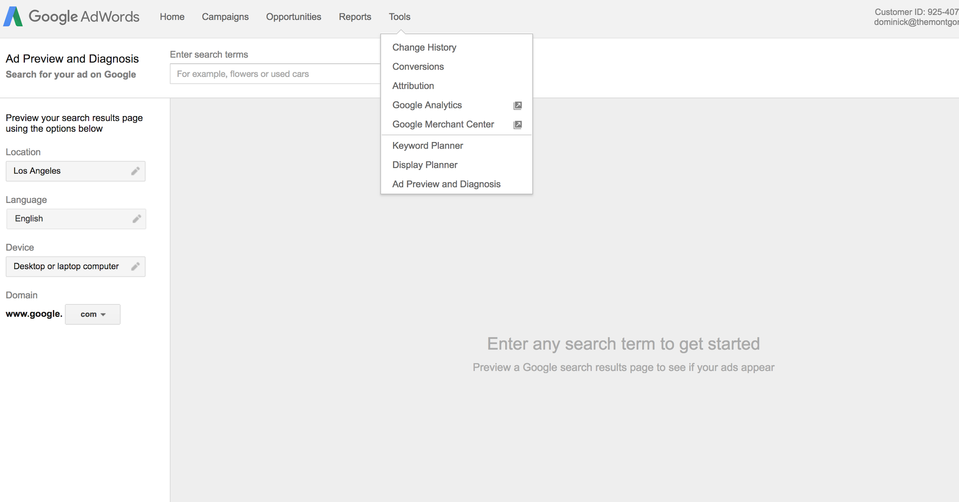

Slide 35
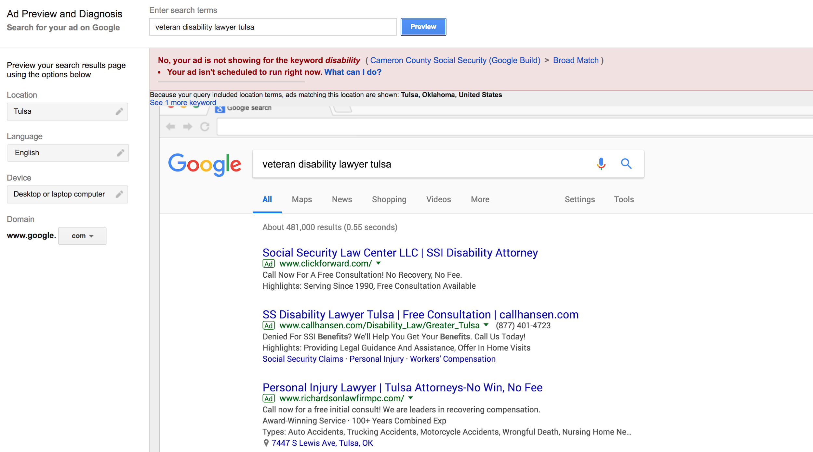

Slide 36
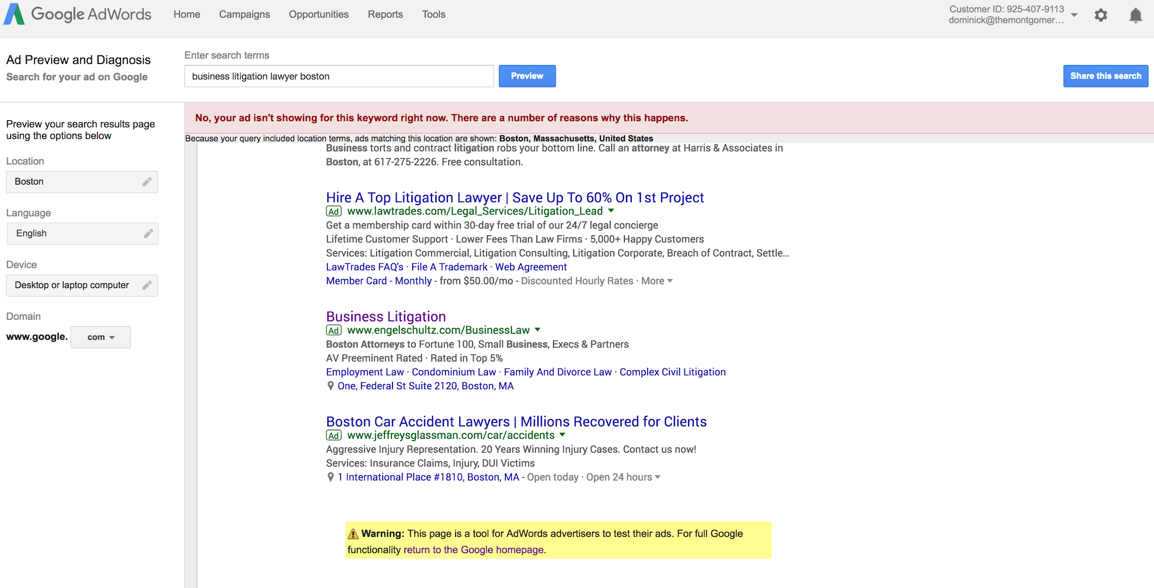

Slide 37
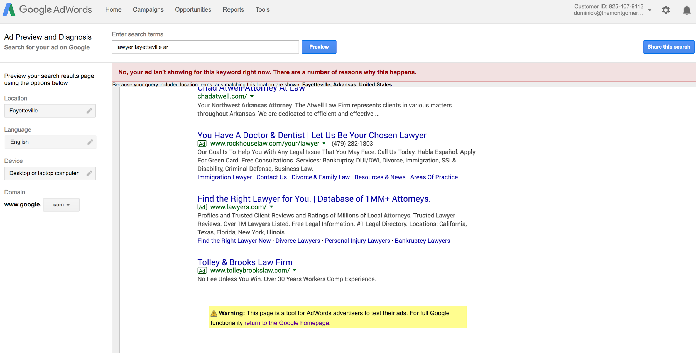

Slide 38
The Process Of Defining Your Niche.
Industry Research
What industries are used to paying premium costs for work we feel is “easy”?
Define a Problem
How can you provide more value than the “competitors” in this space?
Attack That Shit
Find a way in. Find an issue with their online efforts and let them know about it.

Slide 39
What does the outreach sound like?

Slide 40
Industry Numbers
 | Up-Front | Monthly (SEO/PPC) | Annually
PI Attorneys | 10k-20k | 3k-5k | 36k-60k
Med Mal Attorneys | 15k-30k | 5k-8k | 60k-96k
Business Attorneys | 3k-5k | 1.5k-3k | 18k-36k

Slide 41
Agencies aren’t for everybody.
4.

Slide 42
Ways to avoid becoming overwhelmed and underperforming.
Create a process. (Redbooth)
Test out VAs. (Rigorous process but worth it)
Once you find the perfect VA, outsource your ass off. (While retaining a reasonable profit.)

Slide 43
1 Website
$5k up-front
$1500 a month

Slide 44
1 Website
$5k up-front
$1500 a month
Process established.

Slide 45
1 Website
$5k up-front
$1500 a month
Process established.
$250 up-front OS
$150/mo (SEO/Backlinking/Directory Listings, etc.)

Slide 46
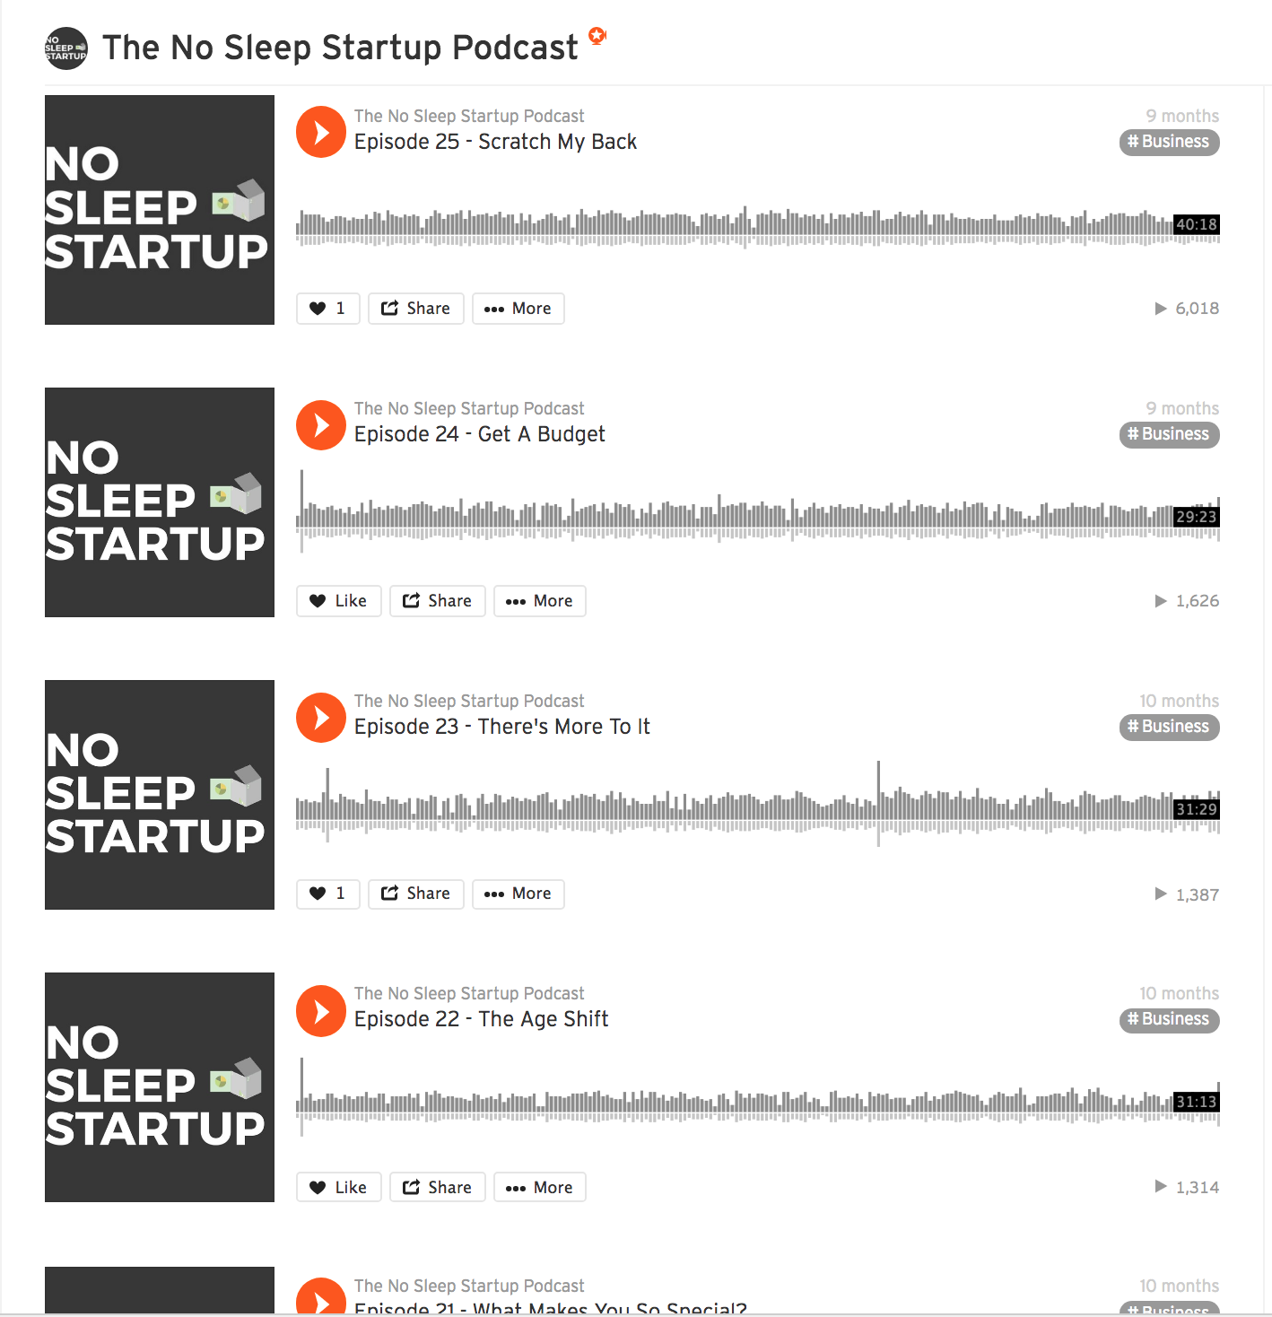
The No Sleep Startup Podcast

Slide 47
The Montgomery Group
Dominick@TheMontgomeryGroup.us

