Slide 1
Gutenberg:
The Future of Editing and Best Practices
By: Lance Howell

Slide 2
WARNING: Disclaimer Ahead

Slide 3
Remember that Gutenberg is in beta or has recently been released by the time you hear or see this presentation, as such, things may have changed. Gutenberg changes everyday. The presentation is trying to be a general guide, and some best practices no matter what post editor you use, but it also is going to dispel some of the Myths and Rumors about Gutenberg that has made the community scared to try it. Remember if you do try it. Just test it out on your test sites or development environment first before trying it out in a live environment. Especially while it is in BETA STATUS!!!! While it is in beta it changes everyday. You will see updates multiple times a week.
You Have Been WARNED!!! HAHAHAHA!!! ☺

Slide 4
What Problem is Being Solved
“The goal is to make adding rich content to WordPress simple and enjoyable.” – From the Gutenberg plugin description on WordPress.org.
Gutenberg enables WordPress to build content layouts, not just write articles.
Learn to write once
Gutenberg is focused on writing.
Embed rich content into the documents.
Notes:
Gutenberg is focused on writing. It provides a “distraction free environment. So those that spend your life or the majority of your life writing then I think it will be a good solution for you. Especially if you write on a smaller screen such as a Tablet or Laptop.
In The State of the Word 2016, Mullenweg announced that the visual editor would be one of three core focuses for 2017.
Read Matt’s take on Gutenberg here https://ma.tt/2017/08/we-called-it-gutenberg-for-a-reason/

Slide 5
Compare The New with the Old
Notes:
The visual editor has been stagnant for years.
While it’s predictable, it’s not exactly a fantastic experience.
The goal is to have an interface that is more intuitive for new users like those offered by Wix and Squarespace.

Slide 6
8 Myths About Gutenberg
You can not turn off the new editing experience.
No support for meta boxes.
No support for custom post types.
Shortcodes will not work.
You need to change your theme.
Gutenberg is a page builder.
Gutenberg is switching away from React.
You have to build blocks in React.
Notes:
Myth #1: You cannot turn off the new editing experience: A user interface change this big may well require traing and time to plan. You will be able to upgrade to WordPress 5.0 yet keep the current editor experience. You can use a plugin called Classic Editor to accomplish this. You can also use a block called “Classic Text”. This is essentially the current editor. Posts created in the pre-Gutenberg era should load into the Classic Text block with no problems.
Myth #2: Meta boxes are a feature that enables information about your content to be entered. It has been merged in and is available since Gutenberg 1.5 released on October 24, 2017. The current implementation has an area below the editor called “Extended Settings,” and this is where you will find your meta boxes.
Myth #3: Custom post types enable developers to build specific content entry forms for different types of content. This was a major fear within the WordPress Community. Custom Post Types are vital when it comes to extending WordPress especially for non-coders. The plan is to allow custom post types to specify the blocks they require, as well as define a default block for the post type. Custom post types will also be able to hide much of the new editing experience.
Myth #4: Shortcodes will continue to work. Blocks are being seen as evolution of the shortcode. Instead of having to type in a shortcode you can insert a block. WordPress recommends people to convert their shortcodes into blocks.
Myth #5: Gutenberg will work with all WordPress themes out of the box. Some features such as full-width images and custom color palettes, that need support from the theme. These are turned off by default and need to be turned on by the theme explicitly.
Myth #6: It will not yet offer all the features that a typical page builder such as Beaver Builder provides. Gutenberg does not yet enable columns, nested blocks or drag and drop.
Myth #7: Facebook who owns the copyright to React switched React’s license to MIT. The MIT license is acceptable to almost everyone, and on September 24, 2017 Matt accounced Gutenberg has stuck with React. At least for now.
Myth #8: The team is exploring framework-agnostic approaches to building blocks such as web components that would let you use Vue. Vanilla and so forth.

Slide 7
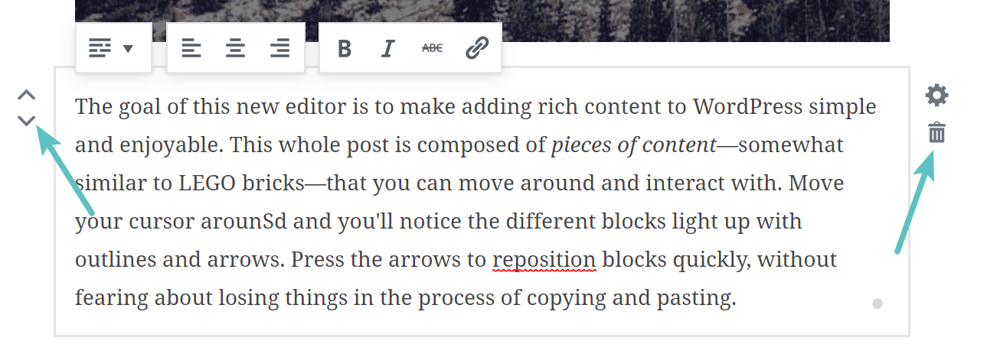
Pros
Doesn’t mess up your posts as bad if you want to deactivate the Gutenberg Experience.
You can easily move up and down the blocks
Works good on a mobile device.
Live HTML Block.
Drag and Drop Images.
Slash Autocomplete.
Pasting Content
Notes:
The text behind the code in textview will show the post text surrounded by <!– wp:core/textà<!--/wp:core/text à so you will know you can just delete those lines of code and your post will be back to normal.
You can insert your code and then see a preview from right within the block.
As of Gutenberg 0.5.0, you can drag and drop images directly into an image block.
Gutenberg 1.1.0 released a feature called Slash Autocomplete. It is the ability to use autocomplete to insert blocks. This will be familiar for those that use Slack. It is a way of quickly formatting content the way you want it. /heading
They are working on new ways to handle pasting content into WordPress from Word, Markdown and Google Docs to native WordPress blocks.
Disabling Gutenberg won’t break your site
Unlike many other page editors, if you uninstall Gutenberg, you won’t break your website.
The special HTML comments are retained in the content so that you can reactivate Gutenberg without losing previously arranged blocks.
Note that without Gutenberg active, the HTML comments are rendered in page source. But since they are just comments, they are benign.

Slide 8
Cons
Missing Markdown support
Doesn’t support responsive columns yet.
Backwards compatibility.
Accessibility
Notes:
This is a reason people install visual builder plugins or shortcode plugins.

Slide 9
Planning for the Release
Try the Gutenberg Plugin.
Your existing pages and posts.
Check this list: https://plugincompat.danielbachhuber.com/
Inform your clients about the upcoming changes.
Training
Remember the Ribbon Bar!!
Notes:
Try the Gutenberg Plugin before it comes to WordPress Core, which is WordPress 5.0.
Your existing pages and posts will be converted to Gutenberg using the “Classic” block. This allows them to exist and display just as they do today without any manual intervention. If you simply prefer the legacy editing experience, you can download the Classic Editor plugin.
Train your clients or office stuff about the new changes. If your clients have to interact with the new editor talk to them over Zoom, skype or Google Hangouts. And give them a demonstration about what has changed and more importantly tell them about their process that has not changed.
Remember the Ribbon BAR.

Slide 10
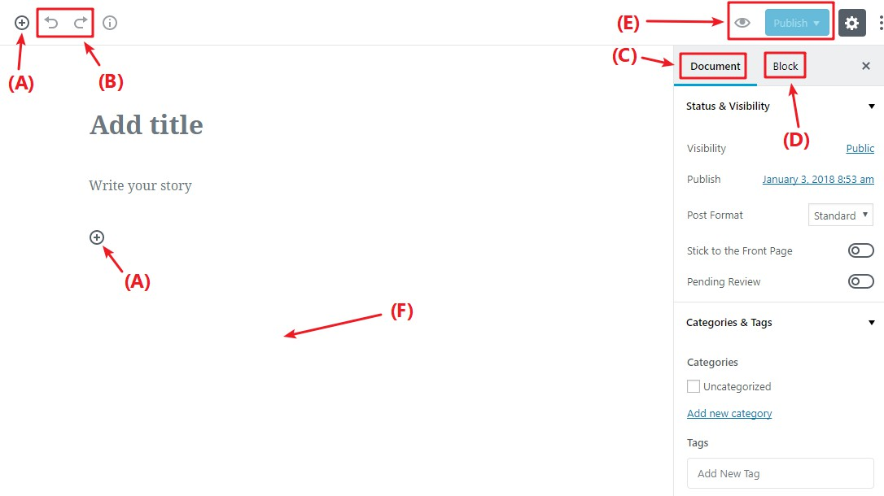
Best Practices
Remember Everything is a Block
Use a Theme that is Designed for Gutenberg.
Build a Basic Layout with Gutenberg.
Use the Recent and Saved Sections
Use /Block-Name for Quick Access to Blocks
Notes:
http://gutenberg.news/
For Best Results Use a Theme that is Designed for Gutenberg. Themes can offer built-in styling for the Gutenberg Blocks.
Diagram
A: Lets you add new blocks.
B: Undo/Redo buttons
C: Gives you access to document settings, covering things like categories and tags, featured images, etc.
D: When you have an individual block selected, this gives you access to settings that are specific to that block.
E: Lets you access a live preview of your post or publish/update your post.
F: Once you add some blocks, this is where you’ll actually work with your post’s content.
Use the recent and saved sections to access blocks that are important to you more quickly.

Slide 11
Contact Me with Questions
By: Lance Howell
https://www.lancehowell.com
lance@lancehowell.com

